Slide 1
How to write a research proposal Research Methodology
PHCL 435
Lab # 5
September, 2023

Slide 2
In previous labs….
Why we develop research questions
Strategies for developing research questions
Formulating your own research questions
Generating research aims and objectives
Will:
Work on our research methodology

Slide 3
Elements of research proposal
Title
Abstract
Table of content
Scientific background and literature review (Research Justification)
Research aims and objectives
Methodology
Work plan (Gantt chart)
References
Appendices

Slide 4

How to write a proposal methodology?

Slide 5
What is your research methodology?
Simply:
How are you going to conduct your research?

Slide 6
Methodology
It describes in detail ‘Where’, ‘Who’, ‘How’ the research will be conducted.
It explains the study design and procedures and techniques used to achieve the proposed objectives.
It defines the variables and demonstrates in detail how the variables will be measured.
It details the proposed methodology for data gathering and processing.

Slide 7
Methodology
Study design
Study population and sample
Sample size
Proposed intervention
Data collection methods, instruments used
Ethical considerations
Statistical Analysis

Slide 8
Methodology: Study design
Cross-sectional, case-control, RCT, etc…
Proper selection of the study design is important to attain reliable and valid scientific results
Proper explanation should be given as to why a particular design was chosen (on the basis of proposed objectives and availability of resources)

Slide 9
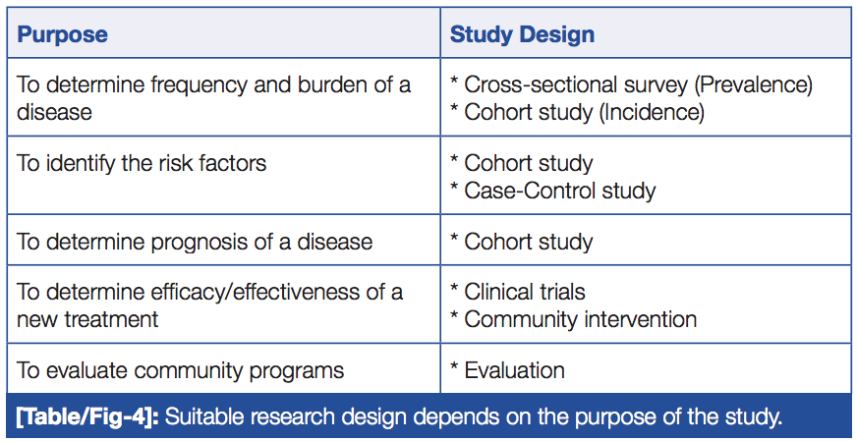
Methodology: Study design
* Al Jundi, A., & Sakka, S. (2016). Protocol Writing in Clinical Research. Journal of clinical and diagnostic research: JCDR, 10(11), ZE10.

Slide 10
Strom, B. and Kimmel S. (2006) Textbook of Pharmacoepidemiology

Slide 11
Methodology: Study population and sample / Study Setting
Where are you going to do the research and who is the study population
Population refers to all the elements (individuals, objects or substances) that meet certain criteria for inclusion.
Sample refers to subset of population which meets the inclusion criteria for enrolment into the study.
Proper definition of eligibility, inclusion, exclusion and discontinuation criteria of the study subjects should be stated.

Slide 12
Methodology: Study population and sample / Study Setting
Allocation of subjects to study arms should be explained and described in details bearing in mind the concealment and randomization process.
Each step involved in the recruitment of the study subjects should be described according to the selection criteria (inclusion and exclusion criteria).
Study setting (if applicable)

Slide 13
Methodology: Sample size
Sample size calculation is recommended for economical and ethical reasons
The sampling technique should be mentioned, e.g., randomization that will be used in order to obtain a representative sample for your target population.
Notes:
A larger sample size than needed to test the research hypothesis increases the
cost and duration of the study and will be unethical if it exposes human subjects to
any potential unnecessary risk without additional benefit. A smaller sample size than
needed can also be unethical if it exposes human subjects to risk with no benefit
to scientific knowledge. The basis on which sample size is calculated should be
explained in the methodology section of the protocol. Calculation of sample size has
been made easy by computer software programs. But the principles underlying the
estimation should be well understood. These have been explained in Chapter 4.

Slide 14
Methodology: Proposed intervention
Full description of proposed intervention should be given.
All the activities and actions should be recorded and thoroughly explained in their order of occurrence
When using drugs, mention both scientific and brand name, name of the manufacturing company, city, and country. Drug route, dosage, frequency of administration, and total duration of treatment
When using apparatus its name should be given followed by the name of the manufacturer, city and country.

Slide 15
Methodology: Proposed intervention
Involved personnel should precisely define:
Who will be responsible for the interventions?
What activities each personnel will perform and with what frequency and intensity?

Slide 16
Methodology: Data collection
Time frame required for the research.
Retrospective data (medical records)
Questionnaires
Interviews (Structured, Semi-Structured)
Laboratory test (literature or personal knowledge should be referenced, if established test, or description should be provided in details, if not established)
Clinical examinations
Notes:
• Retrospective data (medical records)
• Questionnaires
• Interviews (Structured, Semi-Structured)
• Laboratory test (literature or personal knowledge should be referenced, if established test, or description should be provided in details, if not established)
• Clinical examinations
• Description of instruments, tools used for data collection, as well as the methods used to test the validity and reliability of the instrument should be provided

Slide 17
Methodology: Data collection
Description of instruments, tools used for data collection (methods used to test the validity and reliability of the instrument should be provided)
If the researcher is planning to acquire data through interviews or questionnaires, copy of the questions used should be attached as an appendix with the proposal.
Notes:
• Retrospective data (medical records)
• Questionnaires
• Interviews (Structured, Semi-Structured)
• Laboratory test (literature or personal knowledge should be referenced, if established test, or description should be provided in details, if not established)
• Clinical examinations
• Description of instruments, tools used for data collection, as well as the methods used to test the validity and reliability of the instrument should be provided

Slide 18
Methodology: Data collection
Data handling and record keeping
Describe procedures for data collection and recording (software to be used, location of the data..etc)
Detail methods implemented to ensure validity and quality of data (e.g. double entry, cross validation etc)
Security / storage of data
Records retention – duration and location
Notes:
• Retrospective data (medical records)
• Questionnaires
• Interviews (Structured, Semi-Structured)
• Laboratory test (literature or personal knowledge should be referenced, if established test, or description should be provided in details, if not established)
• Clinical examinations
• Description of instruments, tools used for data collection, as well as the methods used to test the validity and reliability of the instrument should be provided

Slide 19
Ethical considerations
The researcher should take special care in ensuring that ethical standards are met.
Ethical considerations refer to:
Protection of the participants' rights (right to self-determination, right to privacy, right to autonomy and confidentiality, right to fair treatment and right to protection from discomfort and harm),
Obtaining informed consent, and the institutional review process (ethical approval)
Study should not start unless approval from ethics committee is received

Slide 20
Ethical considerations
Subject information packages should contain sections on:
Justification for research
Outline of study
Benefits and risks for the subjects involved
Description of the information to be gathered
Alternative treatments/approaches
Voluntary participation (freedom to withdraw from the study)
Confidentiality (how personal information will be kept secret)
Identity of the researcher and supervisor/s and contact details
Attard N. (2018). WASP (Write a Scientific Paper): Writing an academic research proposal. Early Human Development 123 (2018) 39–41
Notes:
Justification for research, outline of study, risks, confidentiality, and voluntary participation should be told patients about the freedom to withdraw from the study whenever they wish to. Confidentiality indicates how the personal information obtained from the patient will be kept secret (Data safety).

Slide 21
Ethical considerations
Informed consent needs to be obtained from the participants.
The consent form should contain details discussed previously under the subject information package
Subjects are entitled to a copy of the signed consent.
Attard N. (2018). WASP (Write a Scientific Paper): Writing an academic research proposal. Early Human Development 123 (2018) 39–41
Notes:
Justification for research, outline of study, risks, confidentiality, and voluntary participation should be told patients about the freedom to withdraw from the study whenever they wish to. Confidentiality indicates how the personal information obtained from the patient will be kept secret (Data safety).

Slide 22
References
Sudheesh, K., Duggappa, D. R., & Nethra, S. S. (2016). How to write a research proposal?. Indian journal of anaesthesia, 60(9), 631.
Al JunDi, A., & SAkkA, S. (2016). Protocol Writing in Clinical Research. Journal of clinical and diagnostic research: JCDR, 10(11), ZE10.
Birmingham City University :How to write a research proposal
Attard N. (2018). WASP (Write a Scientific Paper): Writing an academic research proposal. Early Human Development 123 (2018) 39–41

Slide 23

Questions

